Slide 1
SRS Resident Information System BD
Prepared by : Md Yasin Arif
Supervised by : Rajaul Islam
Technology : Spring Boot, Maven, Spring MVC, Spring Security,Thaymlef, Hibernate,Spring JPA & MySql

Slide 2
Requirements
To Collect information to the residence Government want to launch web application for this purpose we think to build a web application to collect the residence (House Owner, Tenant) information. It is very easy to use any one can first registration as a user and he/she select his/her type and then login the web application and give his/her all required information. Police can see the list of the residence.

Slide 3
Requirements analysis
Create User
Registration User
Get House Owner Information
Get Tenant Information
User can view his/her Profile
User can Update his/her Information
Police can see the List of Resident

Slide 4
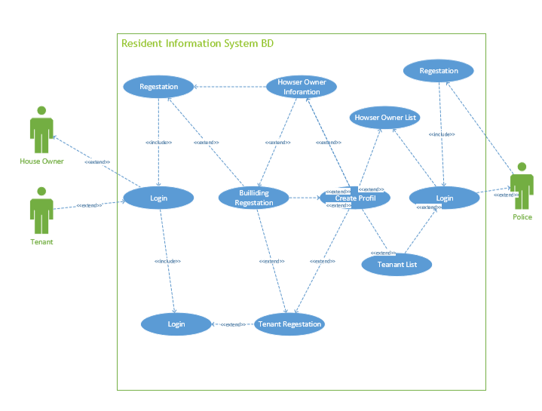
Use Case

Slide 5
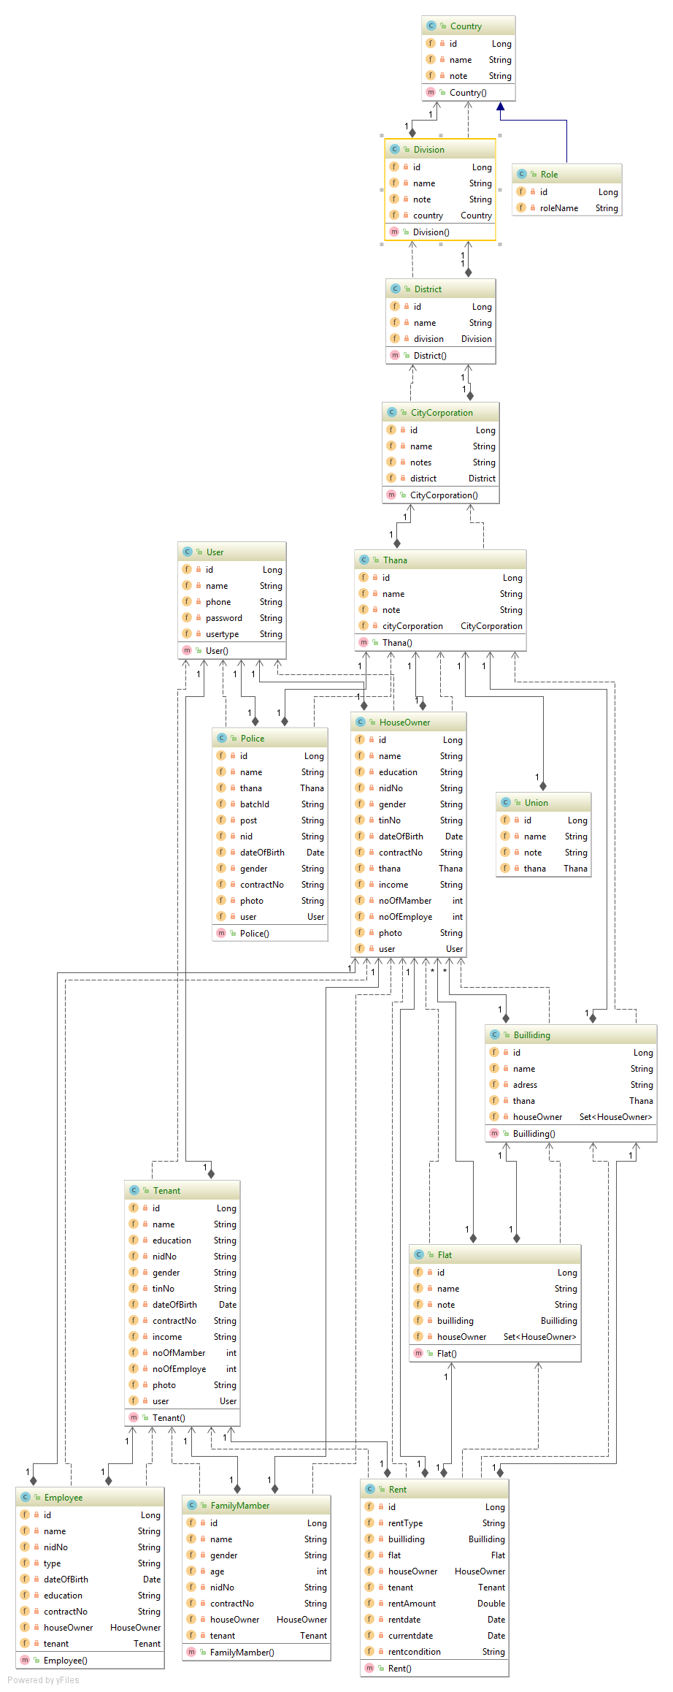
Class Diagram

Slide 6
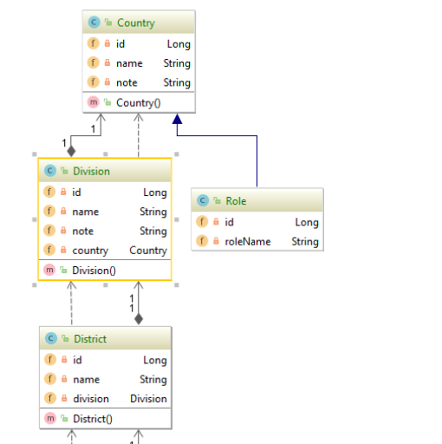
Class Diagram

Slide 7
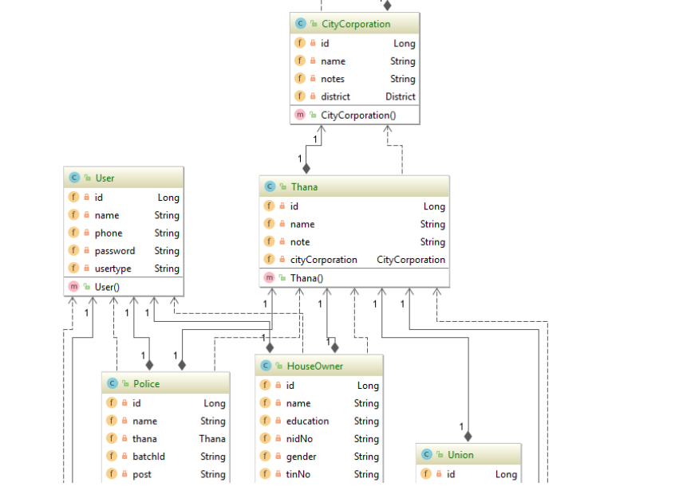
Class Diagram

Slide 8
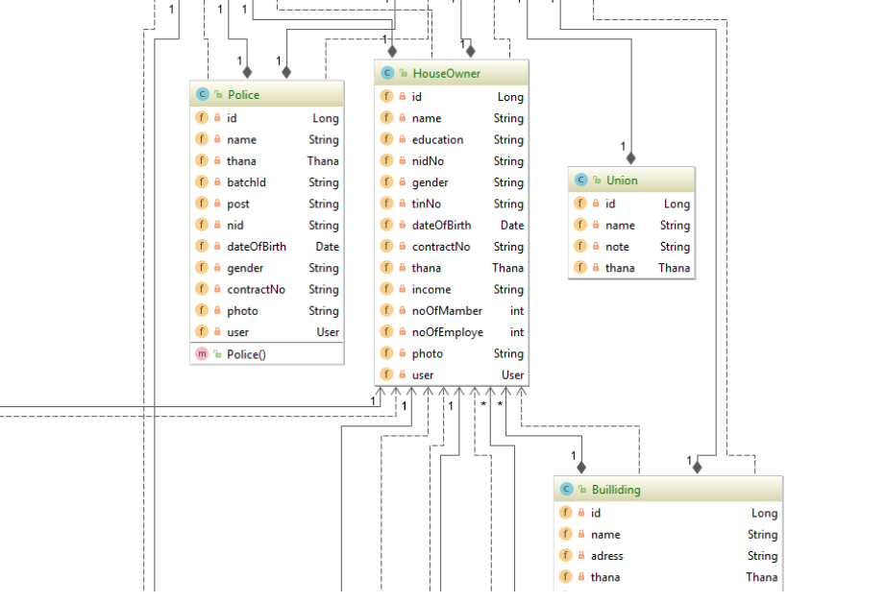
Class Diagram

Slide 9
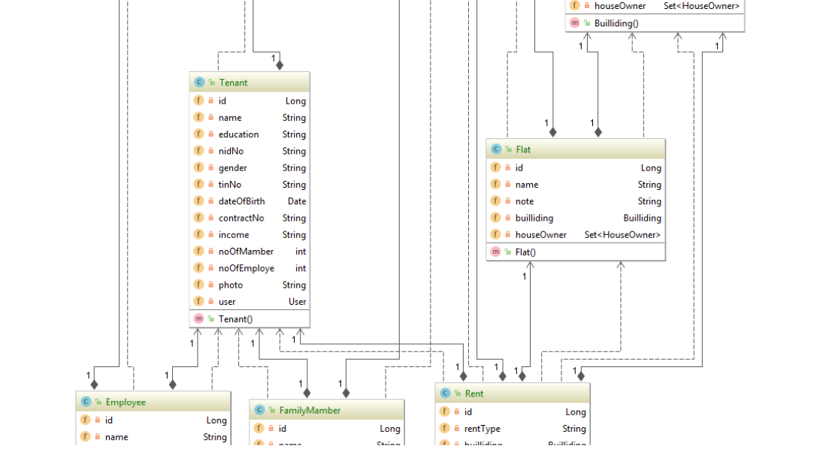
Class Diagram

Slide 10
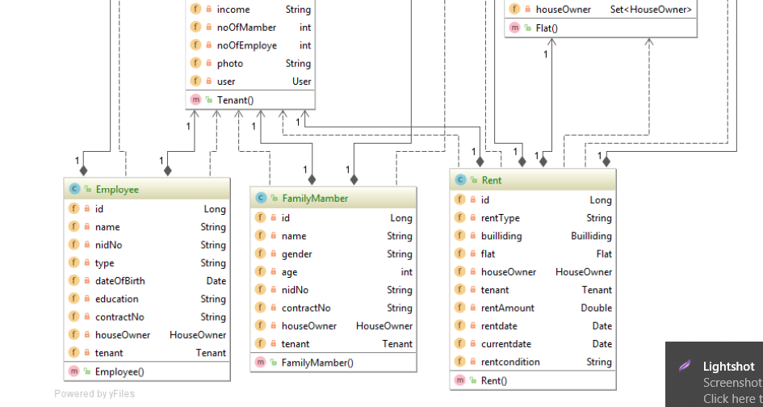
Class Diagram

Slide 11
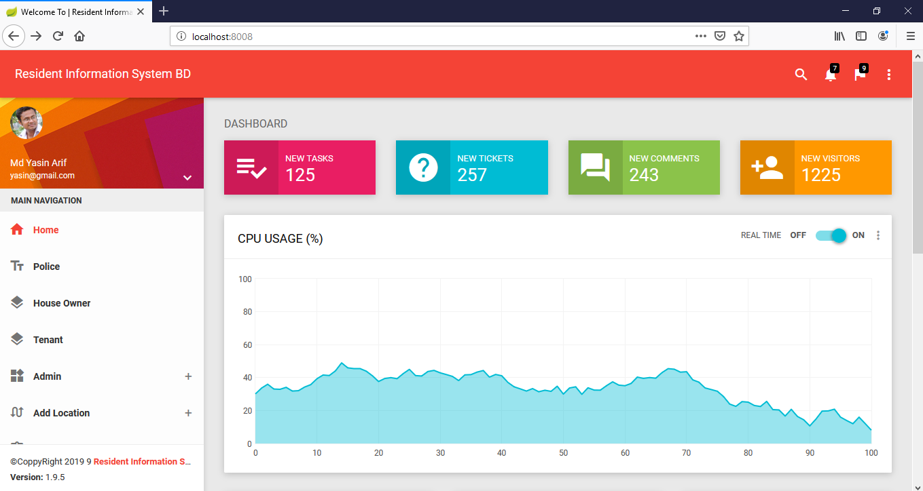
Home Page

Slide 12
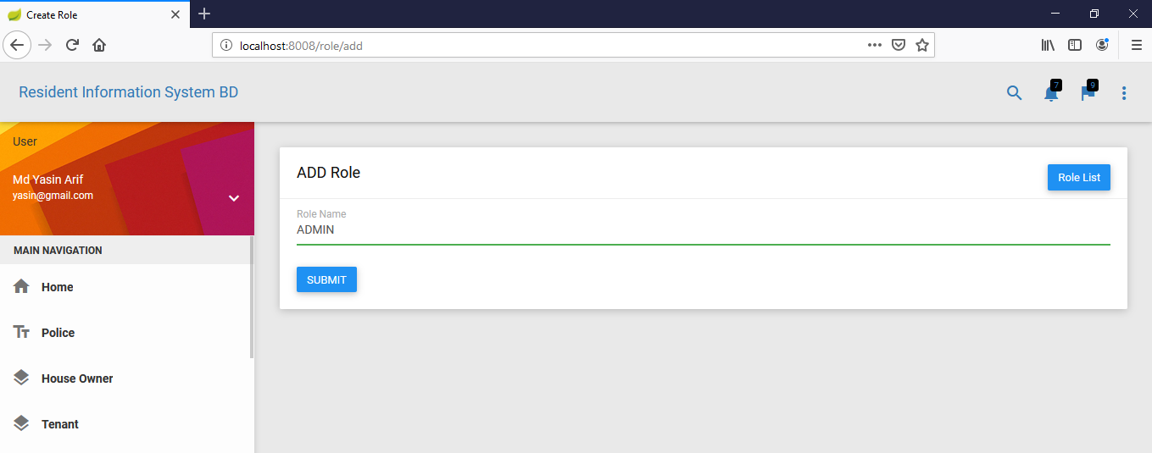
Add Role

Slide 13
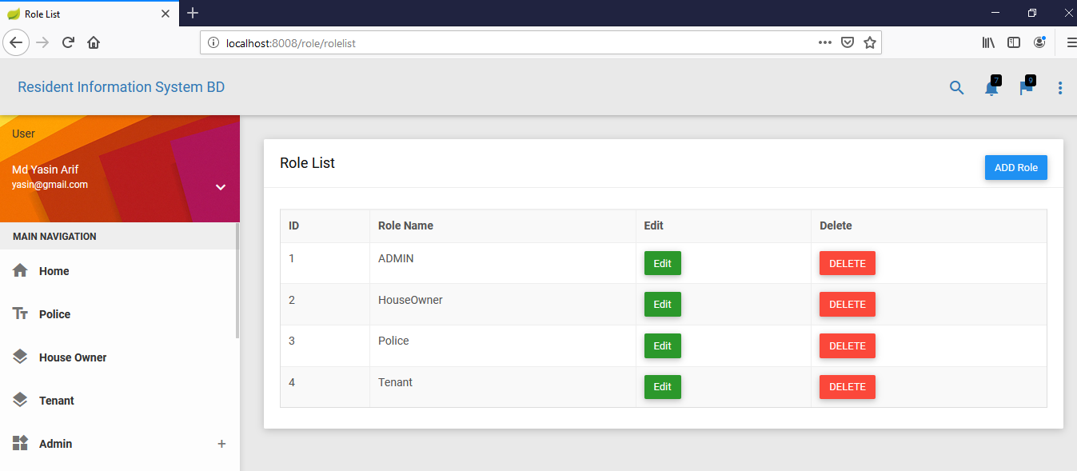
Role List

Slide 14
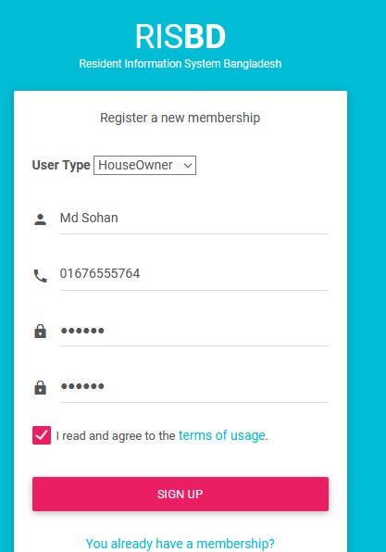
Create User Sing_Up

Slide 15
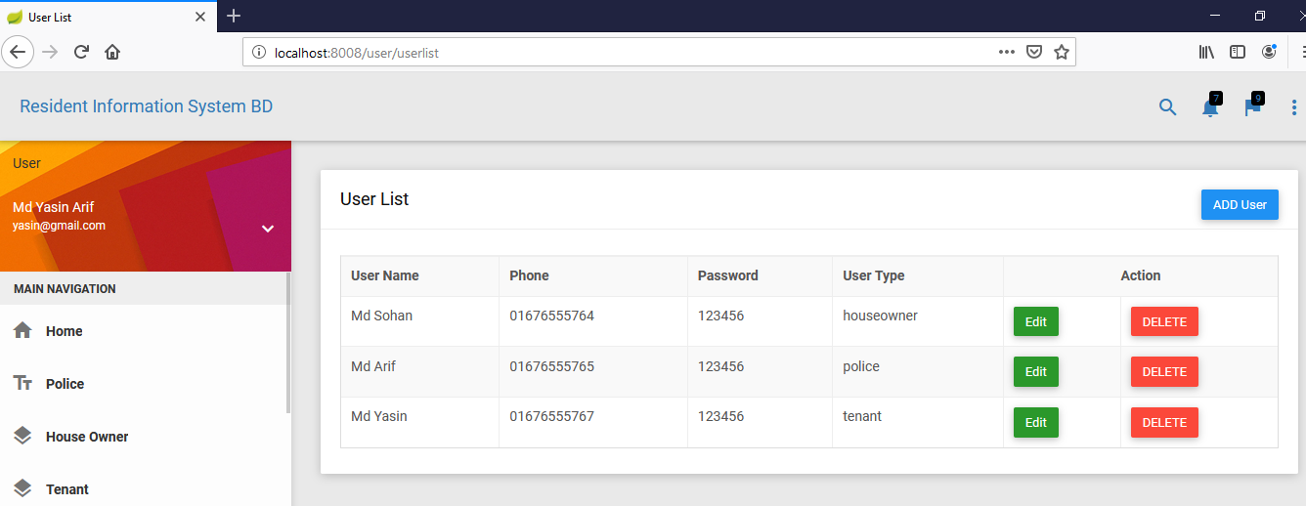
User List

Slide 16
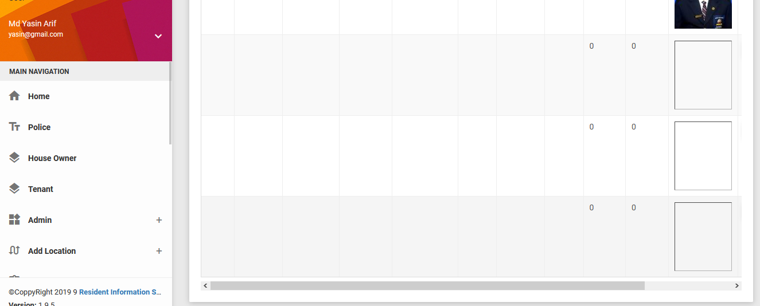
Login User

Slide 17
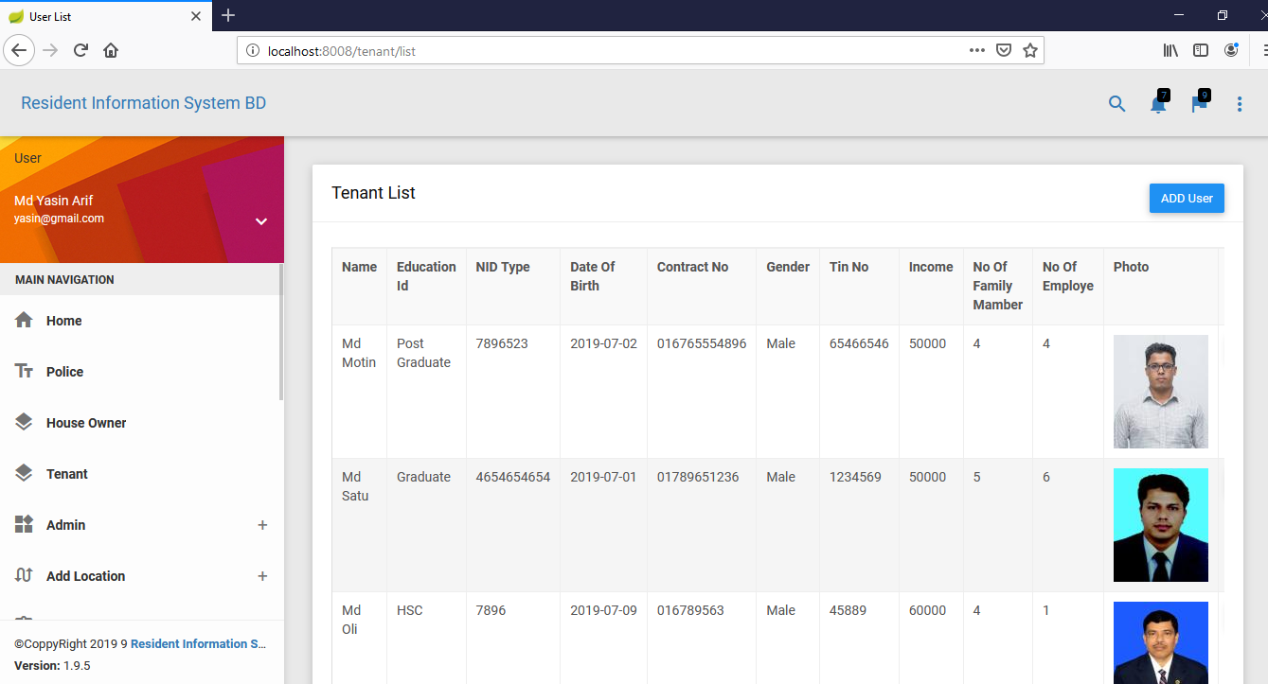
Listed Tenant List

Slide 18
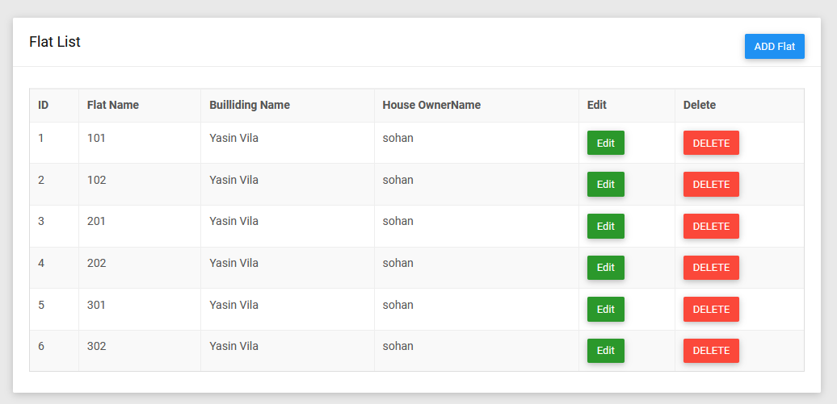
Flat List

